Slide 1





















































CAPITAL GOODS SKILL COUNCIL
TOURISM & HOSPITALITY
SKILL COUNCIL
SCMS
^{HCSSC Handicrafts and} Carpet Sector Skill Council
^{ELECTRON}ICS SECTOR SKILLS COUNCIL OF INDIA

Slide 2
PM Vishwakarma Yojana Scheme (PMVS)
Aadhaar Enabled Biometric Attendance System (AEBAS)

Slide 3
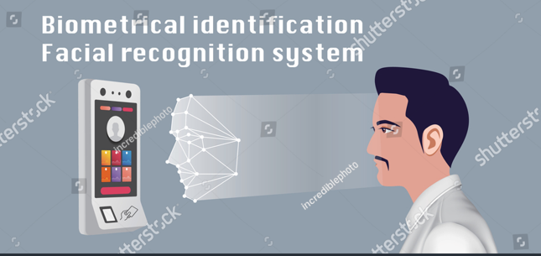
Aadhaar enabled face authentication system
Process Flow
Organization on-boarding on AEBAS
User Registration on AEBAS
How to mobile face auth Activation
Marking Attendance via face auth (geo fencing)
Attendance Report
Important instructions for the TC and candidates

Slide 4
Process Flow
Device Procurement
TC Creation on Skill India Portal(SIP)
Training Center Registration on AEBAS
Candidate Registration on AEBAS
Geo coordinates updation
Application Download via Playstore
Attendance Punching
Downloading Reports
Onboarding Registration Device Activation

Slide 5
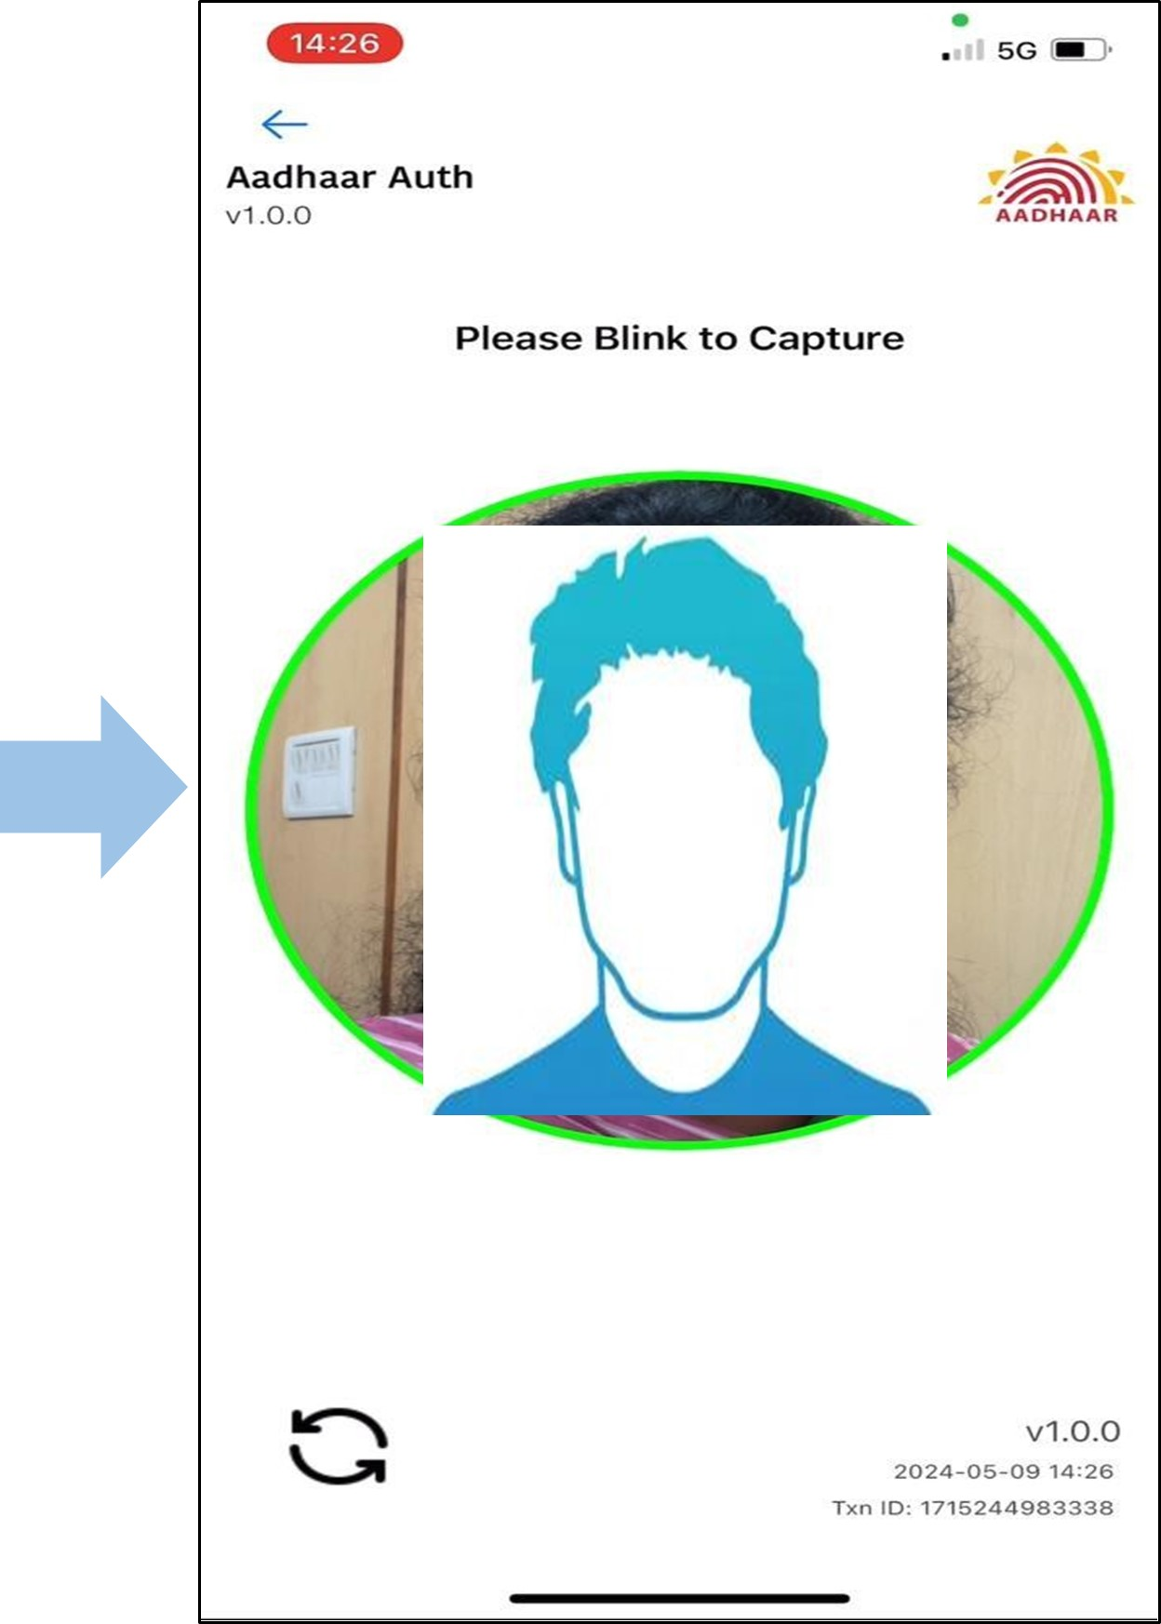
Face Authenticate (Geo fencing)
AEBAS Face Auth
Face Auth
Training Centers are requested to share their Latitude and Longitude coordinates along with geo-tagged photo through the zoho link and email for coordinate updation. The coordinates should be submitted with an accuracy of 50 meters.
Kindly follow the steps below to post shared the Geo-coordinates:
Download the application through Google play store.
Install both application: Aadhaar FaceRD and AadhaarBAS.
Open the Aadhaar BAS application.
Select Attendance Domain >> Schemes >> PM Vishwakarma Scheme >> Submit
Enter Attendance id of the candidate 6. Scan the candidates face for authentication.

Slide 6
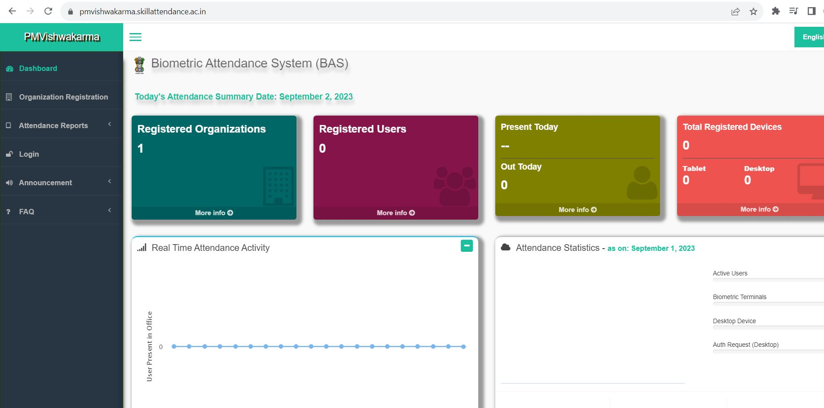
AEBAS Dashboard-At a glance

Slide 7
Organization Registration on AEBAS(1/2)
Users can register their Organization on AEBAS by the steps below:
Go to URL https://pmvishwakarma.skillattendance.ac.in/
Click on Organization Registration Tab on the left side panel.
On the page, you’ll see an online form.
Please enter your TC id.
Select Organization Type : PM Vishwakarma
All the attributes will auto-fill once you enter your TC id.
Enter No. of Candidates (enter approximate no. of candidates to be enrolled in your center)
Click on yes and proceed to Next.
Enter Aadhaar no. of TC SPOC to authenticate.
Enter confirmation code and submit.
The system will provide a temporary Id for you to edit your form when you submit it. Please keep the Temporary id on hand for future reference.
Now, download the on-boarding form and take a printout of the form. Sign and put TC stamp on the hardcopy of the form.
Upload the signed and stamped on-boarding form.
Submit the onboarding form.
Once the application is submitted, it will be reviewed by Operations team. If the verification is successful, you’ll receive an email from noreply.attendance@gov.in with your credentials and the URL of your personalized AEBAS portal for e.g. https://vkxxxxxx.skillattendance.ac.in . In case you have not received login credentials within one or two working days post completion onboarding process. Kindly write on aebashelpdesk@nsdcindia.org & sameer.khan@nsdcindia.org
You can log into your AEBAS portal and begin candidate registration after receiving your credentials.

Slide 8
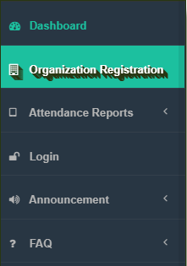
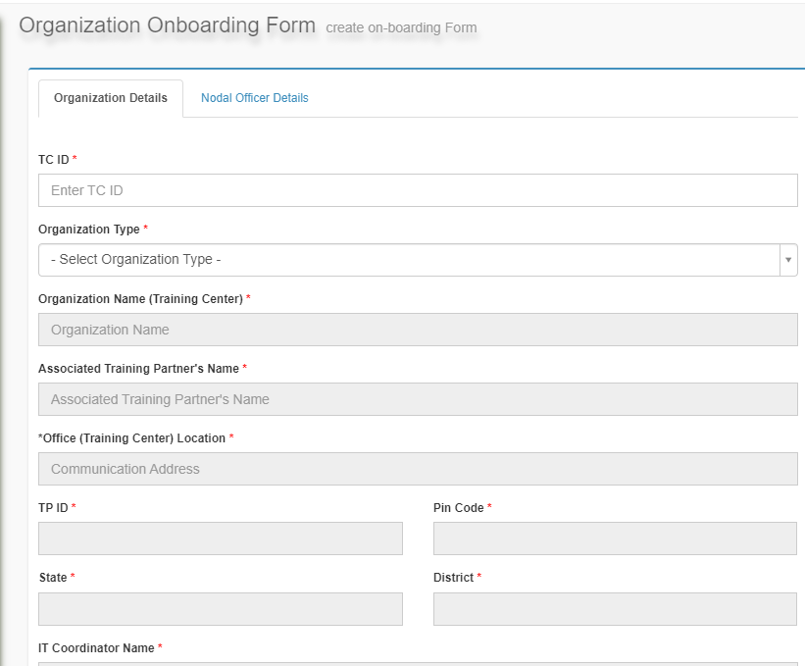

Organization Registration on AEBAS(2/2)
STEP 1
STEP 2
STEP 3
Go to: pmvishwakarma.skillattendance.ac.in
On the left panel, click on Organization Registration
TC must manually enter the TC id.
Details of the TC will auto-fill in the rest of the Tabs
TC must download the prefilled on-boarding form and reupload it after getting signed and stamped
Submit the Online form
Once the application is submitted.
It will be reviewed by Ops Team.
After approval, you will receive your TC portal credentials on your TC SPOC email id.
You may login into your TC portal and start candidate registration

Slide 9
Candidate/Trainer Registration (1/2)
On AEBAS, candidates who are already enrolled/submitted on SIDH can be registered. Users can follow the below process to register on TC AEBAS portal:
Visit your AEBAS portal (for e.g., https://vkxxxxxx.skillattendance.ac.in)
Click on User Registration Tab on the left panel on your TC portal
You will see a candidate / Trainer registration form on the screen
Enter Candidate id “CAN_XXXXXXX”
The system will authenticate the candidate data against the candidate id after you enter it.
Details will auto-fill in the online candidate registration form after authentication is complete.
Enter Aadhaar id.
At this point, the system will verify the candidate's information against the Aadhaar number entered on the UIDAI server. If the candidate's data matches the Aadhaar number, the message "Aadhaar authentication successful" will appear. (Note: Aadhaar name is editable, please enter as per updated Aadhaar card)
Select Employee Type as Trainee/Trainer.
Select Batch id, Designation and Office Location.
Upload Candidate photo
Submit the form.
Now you have successfully registered the candidate on AEBAS.
Kindly note candidate registration number.

Slide 10
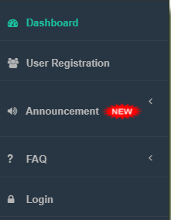
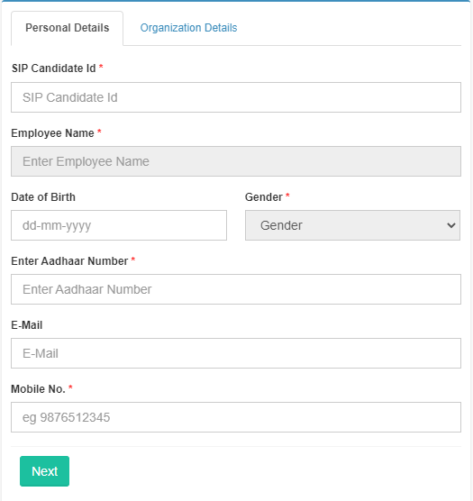
Candidate/Trainer Registration (2/2)
STEP 1
STEP 2
Go to your TC portal.
TC must click on User Registration on the left Panel to register Candidates and Trainers.
Enter the candidate id
Candidate details will auto-fill
Upload photograph and submit the form.

Slide 11

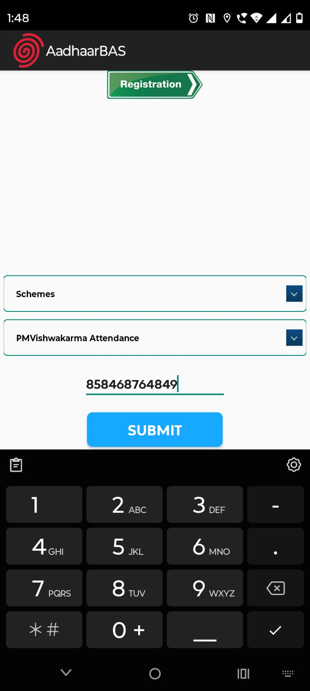
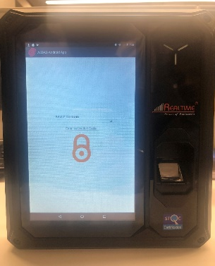
Device Activation
Step 1- App Install from Play store.
Application named as Aadhaar FaceRD and AadhaarBAS.
Device Activation
Install Aadhaar BAS App From Play store / App store.
Install Aadhaar Face RD service from Play store / App store.
Select Domain as scheme and sub domain PM Vishwakarma.
Enter Attendance id (AEBAS registration id).
Scan face to mark attendance.
Step 2- Domain –Scheme and
Sub-domain-PM Vishwakarma
Step 3 Attendance Id (AEBAS registration id )
Step 4- Scan Face

Slide 12
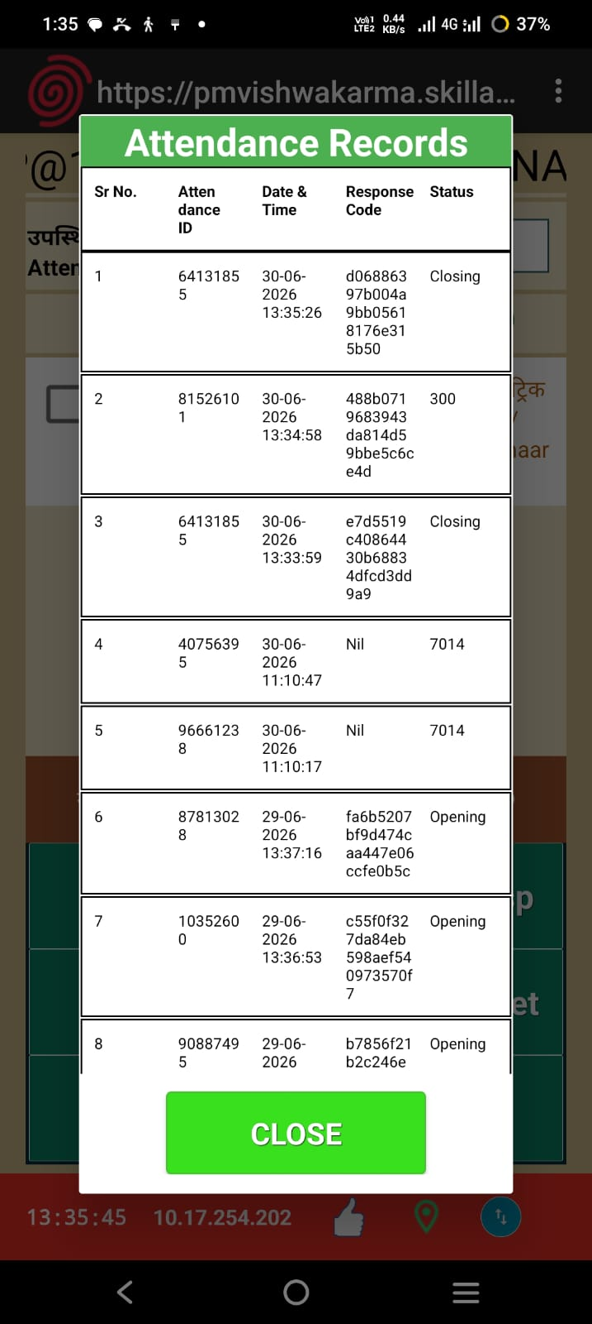
Attendance Marking
Once the device is activated, candidates can start marking attendance on daily basis.
Please follow the below SOP prior to marking attendance:
Enter your 8-Digit Attendance id (AEBAS registration id) and scan face.
Attendance device takes not more than one second to respond.
Device will show an in-time message for the first-time attendance is marked in a day.
Second time attendance marked will be counted as candidate out-time.
For monitoring purposes, time between in-time and out-time will be considered.

Slide 13

Downloading Reports
In AEBAS, Types of reports which can be downloaded are as follows:
• Attendance Today
• Attendance Register
• Advance Reports
• Date-wise Reports
• Weekly/Monthly Reports
• Dynamic Advance Report.

Slide 14

Important instructions for the TC and candidates:
Please note that the following compliances are mandatory for all Training Centers participating under PM Vishwakarma:
Daily Attendance Marking: Attendance for all candidates and trainers under Basic and Advanced skilling batches must be marked and verified daily on AEBAS through face authentication, as per the batches submitted on the PM Vishwakarma portal.
Attendance Monitoring: The attendance marked on AEBAS will be monitored for each candidate and trainer in terms of hours and days.
For error Aadhaar already exist: Please note that all candidates (whether they have completed or not completed the basic training) have been released to the free pool by the NIC team. You may now proceed with the Transfer-IN process for the released candidates.
The steps are below for Transfer IN process: AEBAS login>> Go to Manage Users >> Transfer IN>> Search free Pool Org. User >> Employee (Attendance) ID >> Submit.
Error codes below:
Error 7014: Enter the correct Attendance ID and ensure the candidates are registered under the same TC.
Error 300: Mismatch in the candidate's attendance ID or candidate face.
Error Invalid attendance id: TC have not yet activated the candidates through TC AEBAS login through manage user tab
Note: Mandatory for all candidates and trainers are marking attendance using face authentication (geo fencing within 50 meters) via mobile/tablet for the ongoing or upcoming batches under the PM Vishwakarma scheme.

Slide 15
Thank You

